Slide 1


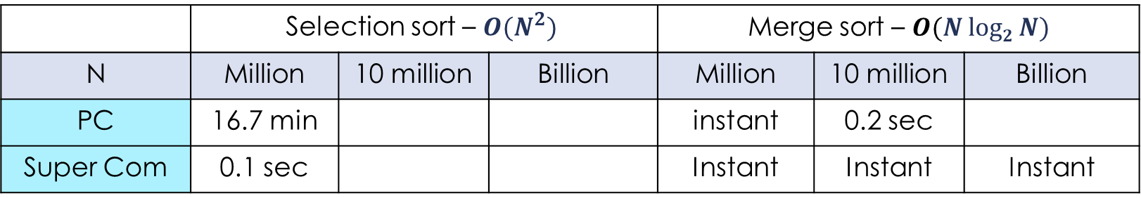
Asymptotic Analysis – Quiz
Example: Running time estimates - empirical analysis
Personal computer executes ${10}^{9}$ compares/second
Super-computer executes ${10}^{13}$compares/second
 | Selection sort – ${O(N}^{2})$ |  |  | Merge sort – $O(N log2 N)$
N | Million | 10 million | Billion | Million | 10 million | Billion
PC | 16.7 min |  |  | instant | 0.2 sec
Super Com | 0.1 sec |  |  | Instant | Instant | Instant
$$\log_{10}2≅0.3$$
$$86,400sec/day$$
instant < 0.1 sec
Use a reasonable or understandable time units.
Do not say, for example, "3660 days" nor "1220 seconds",
but 10.0 years or 20.3 min, respectively.
※ Bottom line: Good algorithms are better than supercomputers.

Slide 2

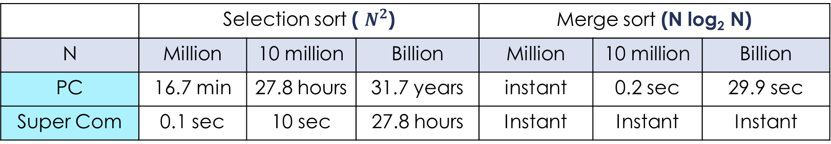
Asymptotic Analysis
Example: Running time estimates - empirical analysis
Personal computer executes ${10}^{9}$ compares/second
Super computer executes ${10}^{13}$compares/second
 | Selection sort ( $N^{2}$) |  |  | Merge sort (N log₂ N)
N | Million | 10 million | Billion | Million | 10 million | Billion
PC | 16.7 min | 27.8 hours | 31.7 years | instant | 0.2 sec | 29.9 sec
Super Com | 0.1 sec | 10 sec | 27.8 hours | Instant | Instant | Instant
$$\log_{10}2≅0.3$$
$$86,400sec/day$$
instant < 0.1 sec
Use a reasonable or understandable time units.
Do not say, for example, "3660 days" nor "1220 seconds",
but 10.0 years or 20.3 min, respectively.
※ Bottom line: Good algorithms are better than supercomputers.

Slide 3

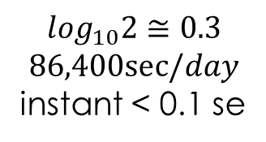
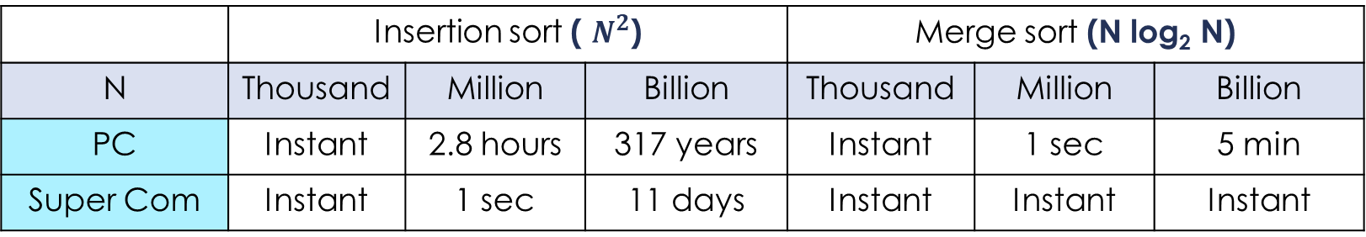
Asymptotic Analysis
Example: Running time estimates - empirical analysis
Personal computer executes ${10}^{8}$ compares/second
Super computer executes ${10}^{12}$compares/second
 | Insertion sort ( $N^{2}$) |  |  | Merge sort (N log₂ N)
N | Thousand | Million | Billion | Thousand | Million | Billion
PC | Instant | 2.8 hours | 317 years | Instant | 1 sec | 5 min
Super Com | Instant | 1 sec | 11 days | Instant | Instant | Instant
$$\log_{10}2≅0.3$$
$$86,400sec/day$$
instant < 0.1 se
Use a reasonable or understandable time units.
Do not say, for example, "3660 days" nor "1220 seconds",
but 10 years and 10 days, or 20 minutes 20 seconds.
※ Bottom line: Good algorithms are better than supercomputers.

